Slide 1
Microservice
Shalini Mittal
Corporate Trainer

Slide 2
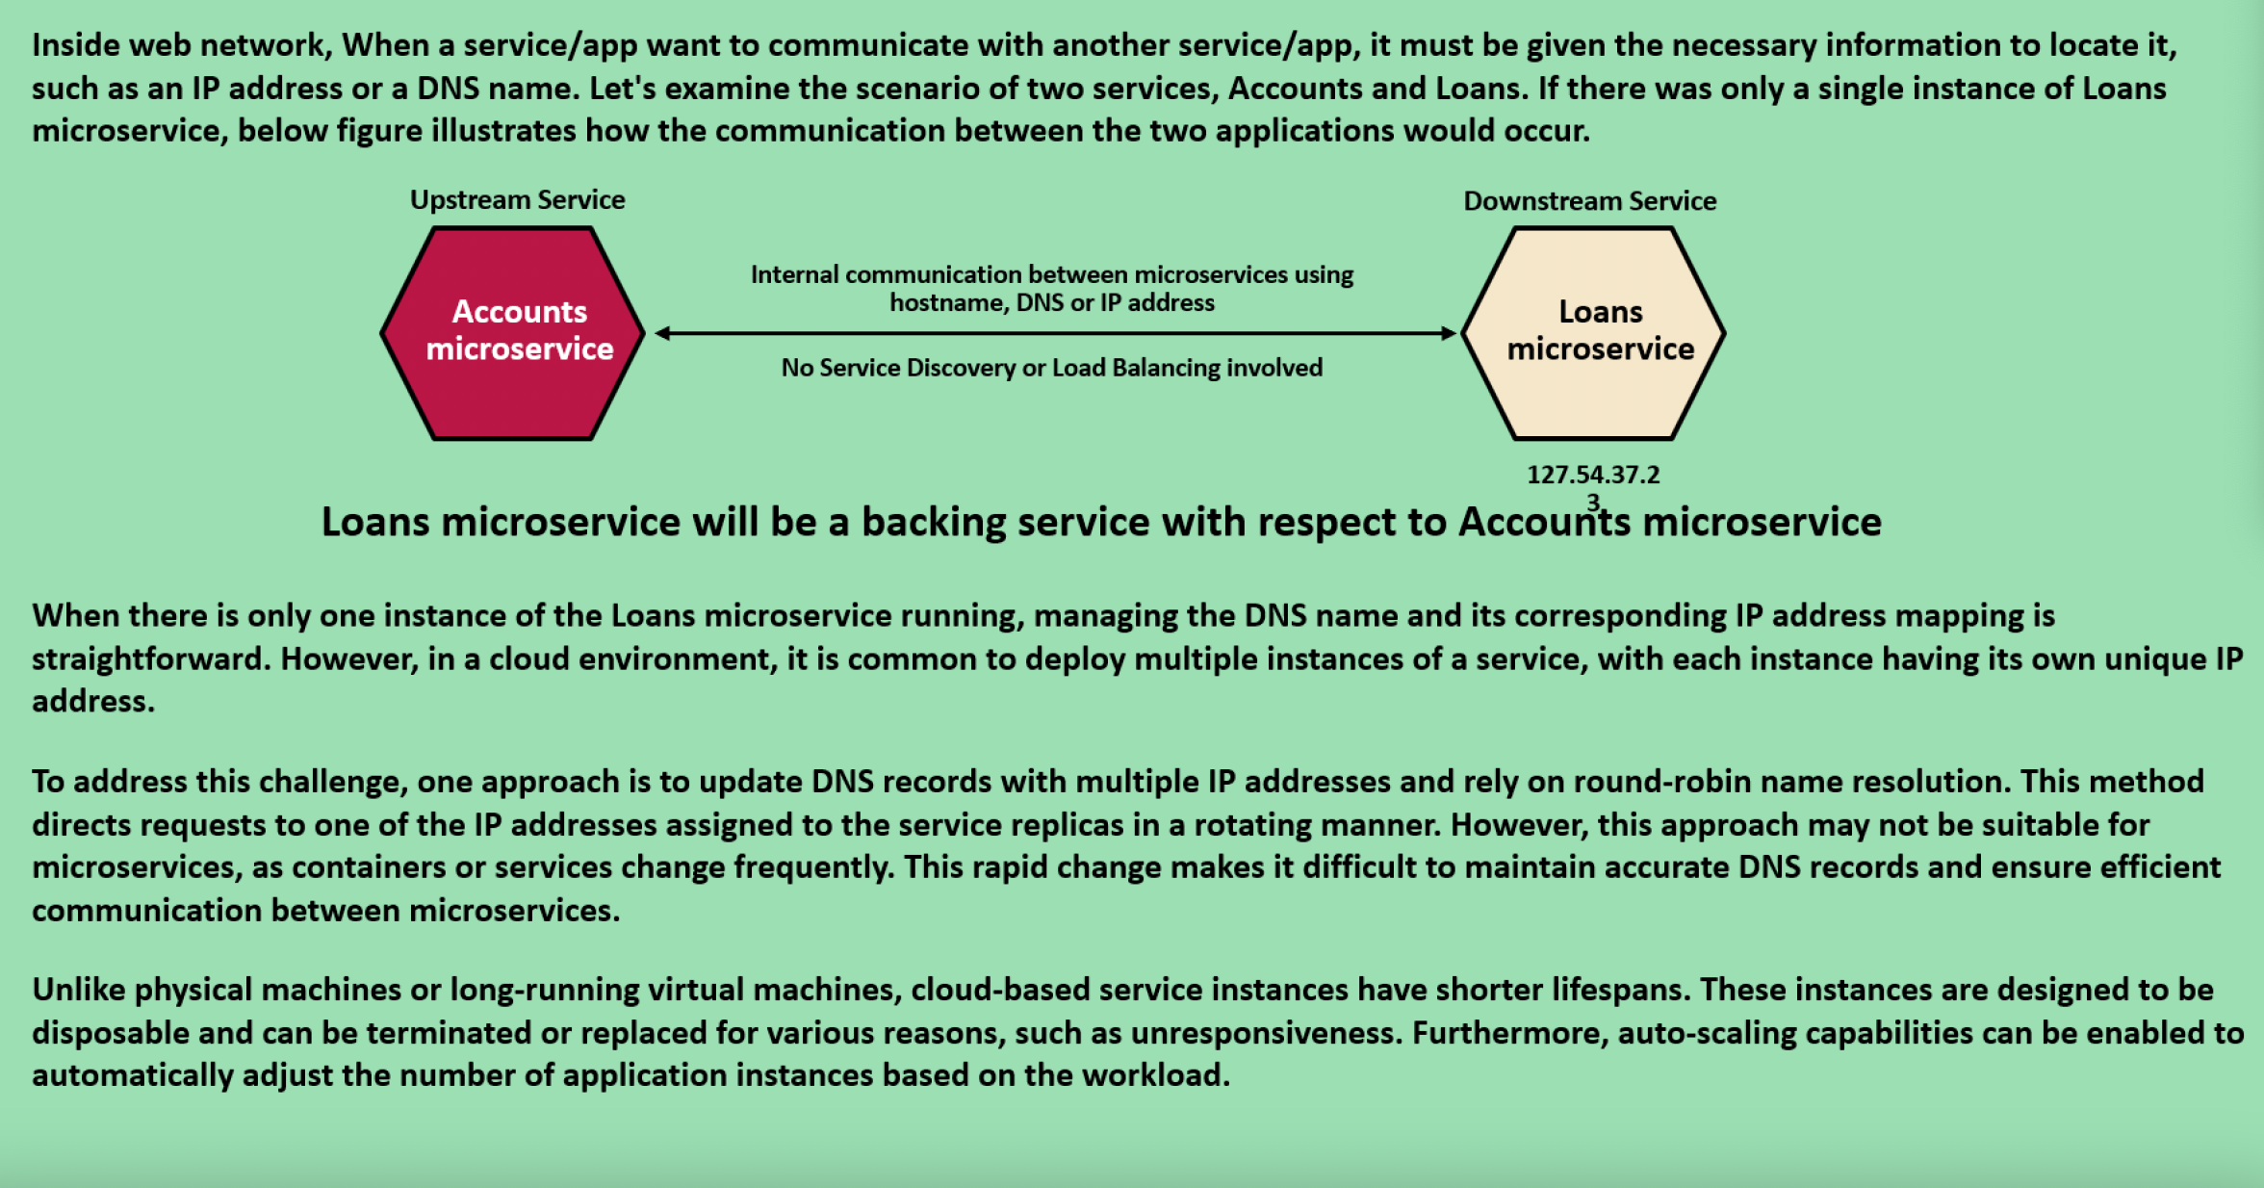
Traditinal Service Communiation
Notes:
https://www.journaldev.com/8195/spring-boot-cli-setup-and-helloworld-example

Slide 3
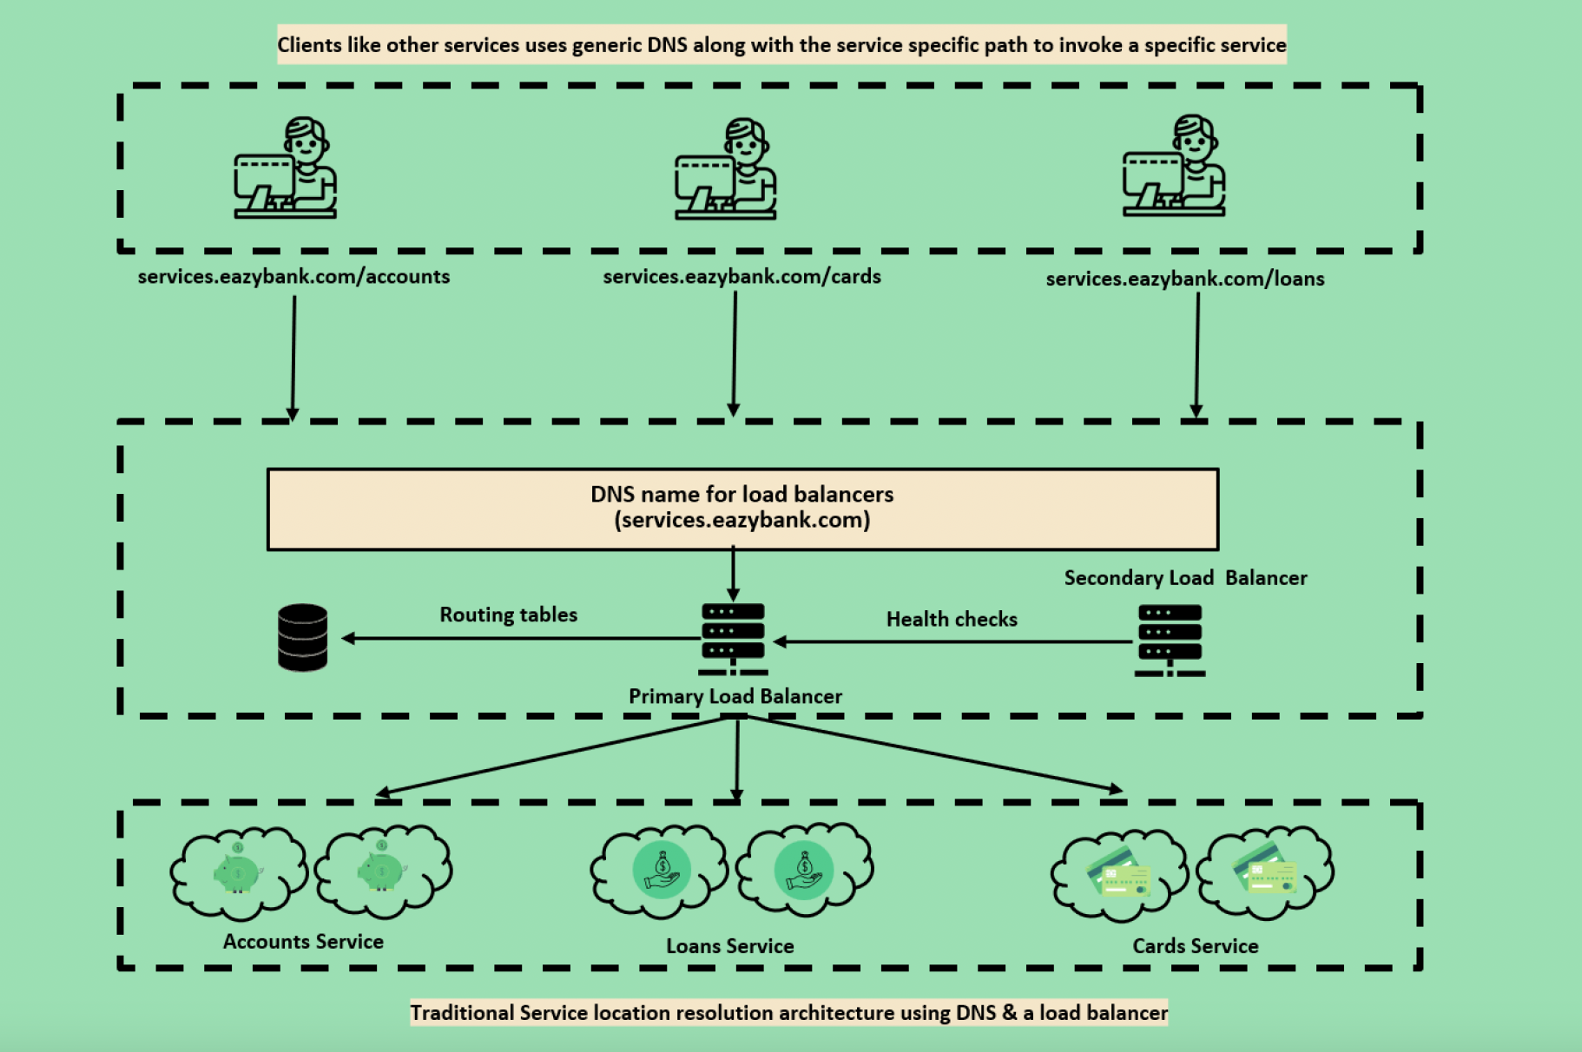
Traditional Load Balancers
Notes:
https://www.journaldev.com/8195/spring-boot-cli-setup-and-helloworld-example

Slide 4
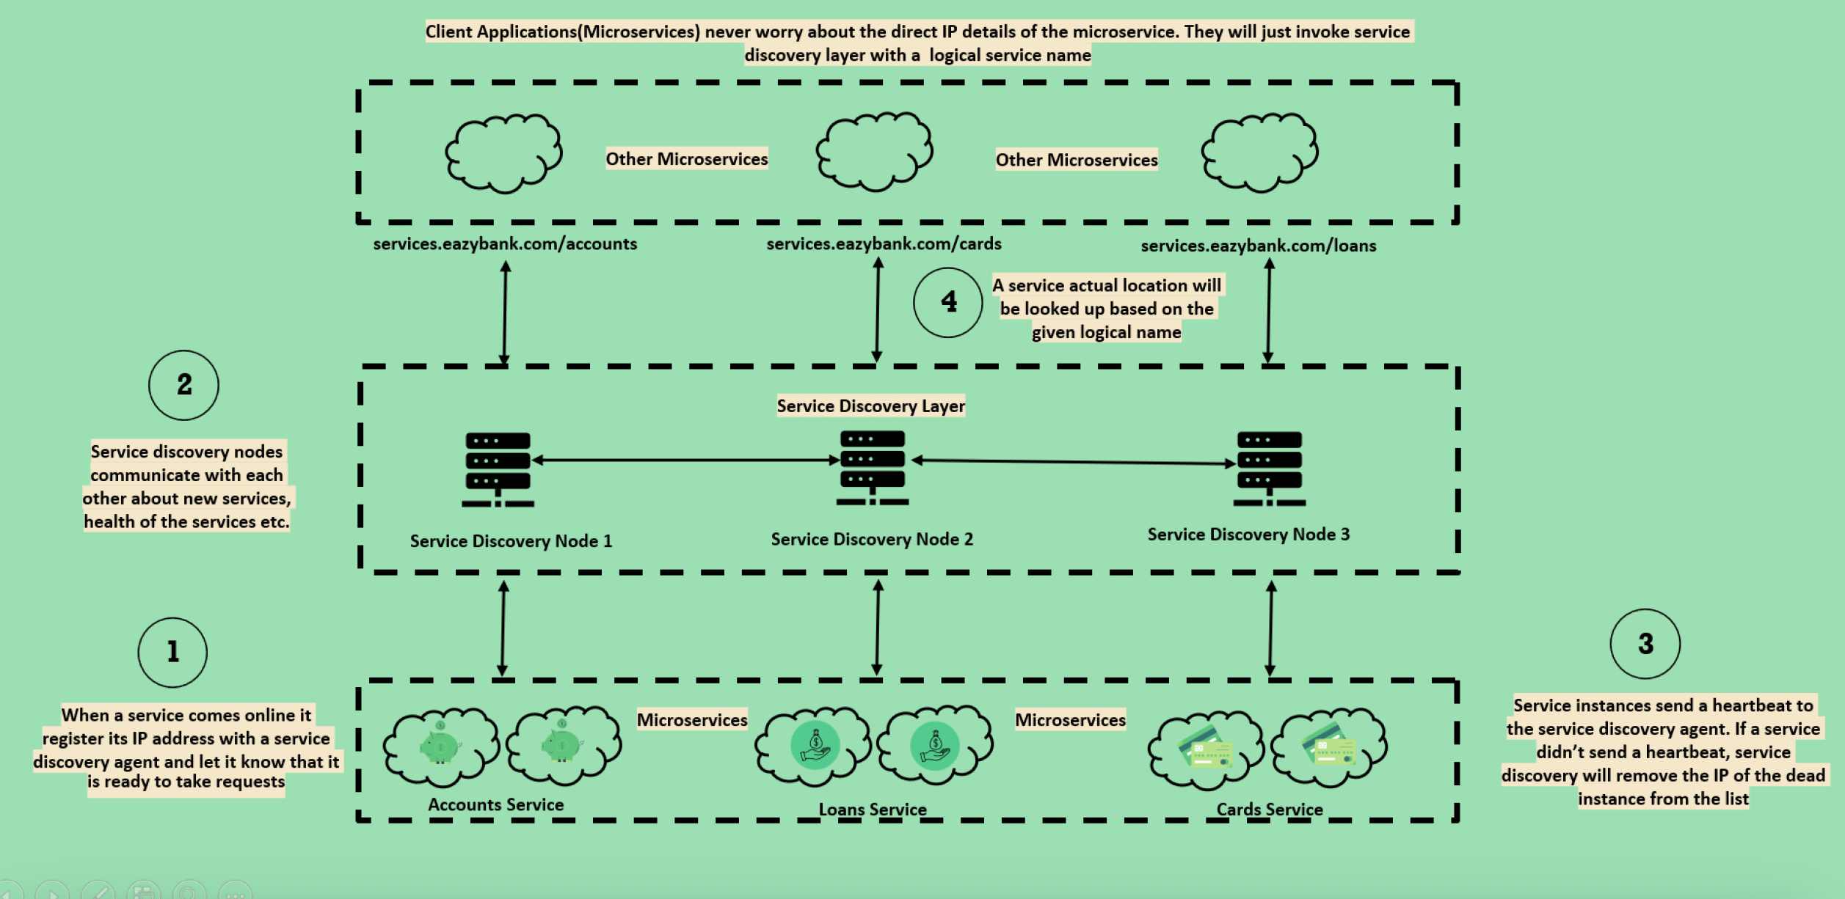
Client Side Discovery
Notes:
https://www.journaldev.com/8195/spring-boot-cli-setup-and-helloworld-example

Slide 5
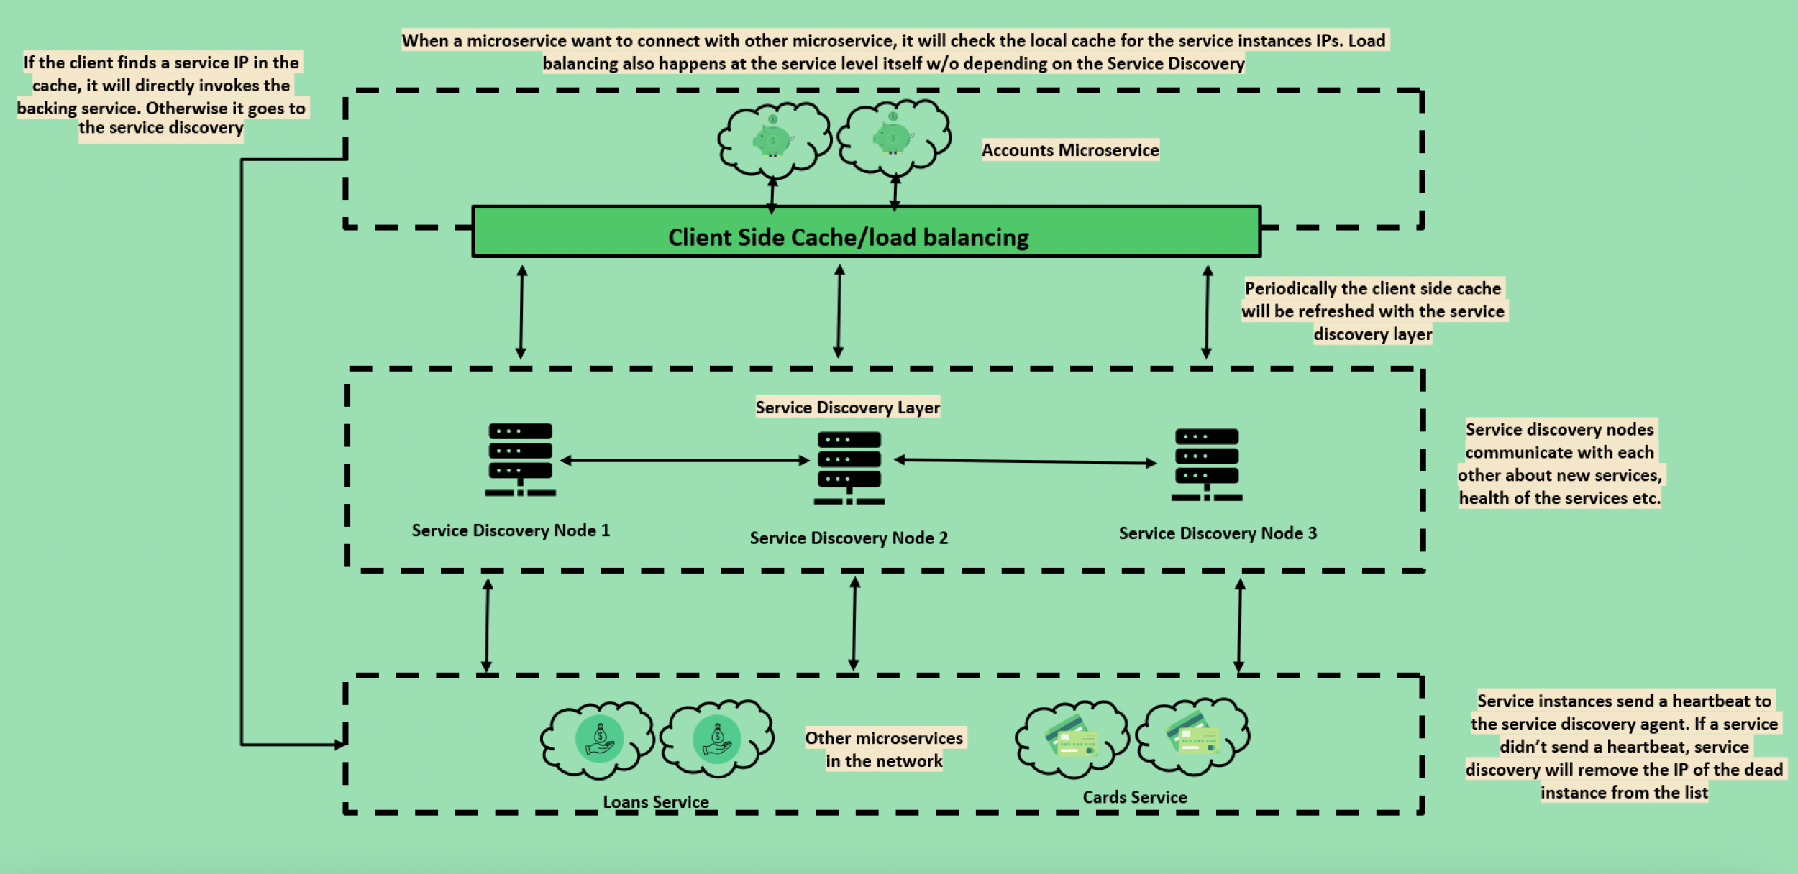
Client Side Load Balancers
Notes:
https://www.journaldev.com/8195/spring-boot-cli-setup-and-helloworld-example

Slide 6
Issues
Hard Coded URL’s
Code change requires for updates
Dynamic urls in cloud
Load Balancing : Multiple instances of same serice
Multiple Environments
Lets understand why hardcoded url wont work in cloud environment
Notes:
https://www.journaldev.com/8195/spring-boot-cli-setup-and-helloworld-example

Slide 7
1. Increased Services
Microservice architecture is all about breaking down monoliths into fine grained services.
This results in an increased number of services that forms a complex communication mesh.
Therefore, it is difficult for one service to maintain the network locations of all the other services, that it has to communicate with, in a property file
Notes:
https://www.journaldev.com/8195/spring-boot-cli-setup-and-helloworld-example

Slide 8
2. Dynamically assigned network locations:
Microservices are generally deployed in the cloud. Server instances in cloud have dynamically assigned network locations.
In addition, due to its basic features such as auto scaling, servers just come and go in cloud. Each time a service is started in a new instance, its network location changes
These complications raised the need to have a more sophisticated mechanism for microservices to dynamically discover the network locations of other microservices for communication.
Notes:
https://www.journaldev.com/8195/spring-boot-cli-setup-and-helloworld-example

Slide 9
Service Discovery

Slide 10
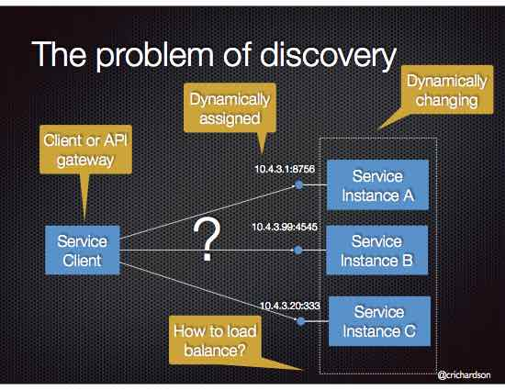
Problem
Implement a mechanism for that enables the clients of service to make requests to a dynamically changing set of ephemeral service instances.
Notes:
https://www.journaldev.com/8195/spring-boot-cli-setup-and-helloworld-example

Slide 11
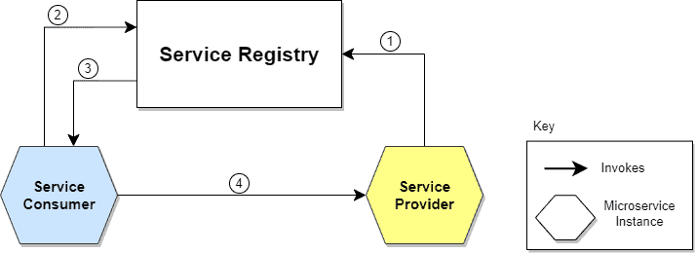
Solution
Service Discovery handles things in two parts.
First, it provides a mechanism for an instance to register and say, “I’m here!”
Second, it provides a way to find the service once it has registered
The location of the Service Provider is sent to the Service Registry (a database containing the locations of all available service instances).
The Service Consumer asks the Service Discovery Server for the location of the Service Provider.
The location of the Service Provider is searched by the Service Registry in its internal database and returned to the Service Consumer.
The Service Consumer can now make direct requests to the Service Provider.
Notes:
https://www.journaldev.com/8195/spring-boot-cli-setup-and-helloworld-example

Slide 12
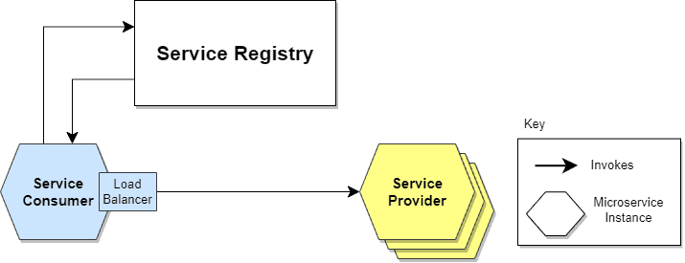
Client Side Discovery
When making a request to a service, the client obtains the location of a service instance by querying a Service Registry, which knows the locations of all service instances.
Notes:
The service discovery is implemented using Netflix OSS components. It provides Eureka, which is a Service Registry, and Ribbon, which is an HTTP client that queries Eureka in order to route HTTP requests to an available service instance.
Giving responsibility for client-side load balancing is both a burden and an advantage. It’s an advantage because it saves an extra hop that we would’ve had with a dedicated load balancer. It’s a disadvantage because the Service Consumer must implement the load balancing logic.

Slide 13
Client Side Discovery
Client-side discovery has the following benefits:
Fewer moving parts and network hops compared to Server-side Discovery
Client-side discovery also has the following drawbacks:
This pattern couples the client to the Service Registry
You need to implement client-side service discovery logic for each programming language/framework used by your application, e.g Java/Scala, JavaScript/NodeJS. For example, Netflix Prana provides an HTTP proxy-based approach to service discovery for non-JVM clients.
Notes:
https://www.journaldev.com/8195/spring-boot-cli-setup-and-helloworld-example

Slide 14
Client Side Discovery
Client-side discovery has the following benefits:
Fewer moving parts and network hops compared to Server-side Discovery
Client-side discovery also has the following drawbacks:
This pattern couples the client to the Service Registry
You need to implement client-side service discovery logic for each programming language/framework used by your application, e.g Java/Scala, JavaScript/NodeJS. For example, Netflix Prana provides an HTTP proxy-based approach to service discovery for non-JVM clients.
Notes:
https://www.journaldev.com/8195/spring-boot-cli-setup-and-helloworld-example

Slide 15
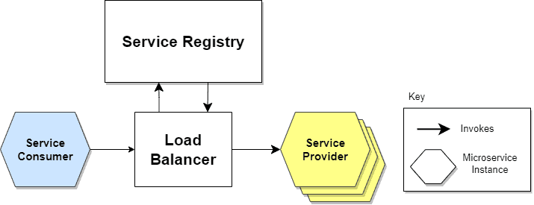
Server Side Discovery
When making a request to a service, the client makes a request via a router (a.k.a load balancer) that runs at a well known location. The router queries a service registry, which might be built into the router, and forwards the request to an available service instance
Notes:
https://www.journaldev.com/8195/spring-boot-cli-setup-and-helloworld-example
In this approach, a dedicated actor, the Load Balancer, does the job of load balancing. This is the main advantage of this approach. Indeed, creating this level of abstraction makes the Service Consumer lighter, as it doesn’t have to deal with the lookup procedure. As a matter of fact, there’s no need to implement the discovery logic separately for each language and framework that the Service Consumer uses.
On the other hand, we must set up and manage the Load Balancer, unless it’s already provided in the deployment environment.

Slide 16
Server Side Discovery Example
An AWS Elastic Load Balancer (ELB) is an example of a server-side discovery router. An ELB also functions as a Service Registry
Some clustering solutions such as Kubernetes and Marathon run a proxy on each host that functions as a server-side discovery router. In order to access a service, a client connects to the local proxy using the port assigned to that service. The proxy then forwards the request to a service instance running somewhere in the cluster.
Notes:
A client makes HTTP(s) requests (or opens TCP connections) to the ELB, which load balances the traffic amongst a set of EC2 instances. An ELB can load balance either external traffic from the Internet or, when deployed in a VPC, load balance internal traffic.. EC2 instances are registered with the ELB either explicitly via an API call or automatically as part of an auto-scaling group

Slide 17
Server Side Discovery Pros and Cons
Server-side service discovery has a number of benefits:
Compared to client-side discovery, the client code is simpler since it does not have to deal with discovery. Instead, a client simply makes a request to the router
Some cloud environments provide this functionality, e.g. AWS Elastic Load Balancer
It also has the following drawbacks:
Unless it’s part of the cloud environment, the router must is another system component that must be installed and configured. It will also need to be replicated for availability and capacity.
The router must support the necessary communication protocols (e.g HTTP, gRPC, Thrift, etc) unless it is TCP-based router
More network hops are required than when using Client Side Discovery
Notes:
A client makes HTTP(s) requests (or opens TCP connections) to the ELB, which load balances the traffic amongst a set of EC2 instances. An ELB can load balance either external traffic from the Internet or, when deployed in a VPC, load balance internal traffic.. EC2 instances are registered with the ELB either explicitly via an API call or automatically as part of an auto-scaling group

Slide 18
Service Discovery
Service discovery mechanism uses a central registry to maintain the network locations of all the microservices. If for some reason the IP address and the port number of a particular microservice changes, new values will be immediately re-registered in the registry.
To maintain and discover a service with dynamic addresses, we need “Service Registration and Discovery”
One dedicated server is responsible to maintain all microservices deployed and registered
Acts like a phonebook of all microservices
Spring provides Eureka server to maintain the microservices and monitor the health if the microservice registered with Eureka
Spring cloud provides multiple solutions such as Eureka, Zookeeper, Cloud Foundry and Consul to facilitate the process of service discovery
Notes:
https://www.journaldev.com/8195/spring-boot-cli-setup-and-helloworld-example

Slide 19
Eureka Server
A REST based service which is primarily used for acquiring information about services that you would want to communicate with.
This REST service is also known as Eureka Server. The Services that register in Eureka Server to obtain information about each other are called Eureka Clients.
Notes:
https://www.journaldev.com/8195/spring-boot-cli-setup-and-helloworld-example

Slide 20
Create Eureka Server
spring: application: name: "eurekaserver" config: import: "optional:configserver:http://localhost:8888/" management: endpoints: web: exposure: include: "*" health: readiness-state: enabled: true liveness-state: enabled: true endpoint: health: probes: enabled: true
Create a spring boot app with following dependencies: eureka-server, actuator, config-client
Add @EnableEurekaServer on the class with main()
Add following in application.yml :
Notes:
Tell Eureka not to regiter yourself and not to look up for any servers running.

Slide 21
Eurekasever.yml on git repo
server:
port: 8070
eureka:
instance:
hostname: localhost
client:
fetchRegistry: false
registerWithEureka: false
serviceUrl:
defaultZone: http://${eureka.instance.hostname}:${server.port}/eureka/
Start config server and check if eureka server properties are loaded: http://localhost:8888/eurekaserver/default
Start eureka server and check if server started : http://localhost:8070
Notes:
https://www.journaldev.com/8195/spring-boot-cli-setup-and-helloworld-example

Slide 22
Update all 3 projects as follows:
Add below dependency <dependency> <groupId>org.springframework.cloud</groupId> <artifactId>spring-cloud-starter-netflix-eureka-client</artifactId> </dependency>
Update yml file as follows to register with eureka anc change info for respective application:
management: endpoints: web: exposure: include: "*" endpoint: shutdown: enabled: true info: env: enabled: true endpoints: shutdown: enabled: true
eureka: instance: preferIpAddress: true client: fetch-registry: true register-with-eureka: true serviceUrl: defaultZone: http://localhost:8070/eureka/ info: app: name: "cards" description: "Cards Application" version: "1.0.0"
Notes:
https://www.journaldev.com/8195/spring-boot-cli-setup-and-helloworld-example

Slide 23
Eureka Server Dashboard
Once the services are up and running, on the eureka dashboard clicking on the various links of instances exposes the info URI.
Hit browser with below url: http://localhost:8080/eureka/apps/
It shows XML file with all services information
To see json go to potman and Accept : json we will get json information
Alternatively to see info of individual services: http://localhost:8070/eureka/apps/accounts http://localhost:8070/eureka/apps/loans http://localhost:8070/eureka/apps/cards
Notes:
Tell Eureka not to regiter yourself and not to look up for any servers running.

Slide 24
Shutdown Services
To shutdown the Accounts service make POST request to: http://localhost:8080/actuator/shutdown http://localhost:8090/actuator/shutdown
http://localhost:9000/actuator/shutdown
Notes:
Tell Eureka not to regiter yourself and not to look up for any servers running.

Slide 25
Eureka Server Properties
Spring Boot applications by default run on port 8080 . So override it to 8761 , so that Eureka server wouldn’t conflict with other Eureka client application (Eureka client will run on 8080).
When Eureka starts up, it will try to register itself as a client. For convenience, used eureka.client.register-with-eureka = false configuration to prevent Eureka server from registering itself in the server upon startup.
In a real world scenario, we may have multiple Eureka server nodes acting together as peer registries. When a Eureka server starts up, by default it searches for other peer registries. In order to prevent this in our local setup, used eureka.client.fetch-registry = false configuration.
Can use logging.level.com.netflix.eureka = OFF and logging.level.com.netflix.discovery = OFF properties to turn off the verbose logging.
Notes:
Tell Eureka not to regiter yourself and not to look up for any servers running.

Slide 26
Eureka Client Server Commnication
Register: Eureka client registers the information about the running instance to the Eureka server.
Renew: Eureka client needs to renew the lease by sending heartbeats every 30 seconds. The renewal informs the Eureka server that the instance is still alive. Special Note: Eureka server doesn’t poll service instances (client) to find out their availability. Instead, clients send a heartbeat to Eureka server to inform their availability.
Fetch Registry: Eureka clients fetches the registry information from the server and caches it locally. After that, the clients use that information to find other services.
Cancel: Eureka client sends a cancel request to Eureka server on shutdown. This removes the instance from the server’s instance registry thereby effectively taking the instance out of traffic.
Notes:
Tell Eureka not to regiter yourself and not to look up for any servers running.

Slide 27
Feign Clients

Slide 28
Feign Clients
Spring Cloud OpenFeign is a library provided by the Spring framework to invoke web services to a client.
Feign is a declarative web service client written in Java. It simplifies the process of calling RESTful web services by handling the details of communication and encoding/decoding request/response payloads.
FeignClient is an interface that is automatically implemented by the Feign framework at runtime to provide a client with a specific service.
It allows you to define the methods for calling different endpoints of a service, and it uses HTTP requests under the hood to interact with the service.
Notes:
Tell Eureka not to regiter yourself and not to look up for any servers running.

Slide 29
Add Feign in MS Projects
Add below in all 3 projects: <dependency> <groupId>org.springframework.cloud</groupId> <artifactId>spring-cloud-starter-openfeign</artifactId> </dependency>
Add @EnableFeignClient on the main class
Then copy LoansDto and CardsDto from cards and loans project
Add CustomerDetailsDto class to map with customer details
Update the customer mapper to generate CustomerDetailsDto
Within service folder check for client folder that has feign code
Create an interface IcustomerService and implementation class for the same
Add CustomerController
Check at http://localhost:8080/details
Notes:
Tell Eureka not to regiter yourself and not to look up for any servers running.

Slide 30
Multi Cluster Eureka

Slide 31
Service Registration
Eureka Client is used to communicate with the Eureka server
Eureka client is bootstrapped, it tries to talk with the Eureka server.
It determines its targets using the eureka.client.serviceUrl.defaultZone property.
By default registers with a server on port 8761
To set on diff port: on eureka client add eureka.client.serviceUrl.defaultZone=http://localhost:8082/eureka/
On Eureka Server: server.port=8082 eureka.client.register-with-eureka=false eureka.client.fetch-registry=false eureka.client.serviceUrl.defaultZone=http://localhost:8082/eureka/
Eureka client/microservices share the instance information with the Eureka server and registers themselves with the {service-id } ( spring.application.name ).
Notes:
https://www.journaldev.com/8195/spring-boot-cli-setup-and-helloworld-example

Slide 32
Create Eureka Clients – 1/2
Update the EmployeeProducer and EmployeeConsumer pom files:
<properties>
<java.version>1.8</java.version>
<spring-cloud.version>Greenwich.SR2</spring-cloud.version>
</properties>
<dependency>
<groupId>org.springframework.cloud</groupId>
<artifactId>spring-cloud-starter-netflix-eureka-client</artifactId>
</dependency>
<dependencyManagement>
<dependencies>
<dependency>
<groupId>org.springframework.cloud</groupId>
<artifactId>spring-cloud-dependencies</artifactId>
<version>${spring-cloud.version}</version>
<type>pom</type>
<scope>import</scope>
</dependency>
</dependencies>
</dependencyManagement>
Notes:
https://www.journaldev.com/8195/spring-boot-cli-setup-and-helloworld-example

Slide 33
Create Eureka Clients – 2/2
EmployeeProducer application.properties : spring.application.name=employee-producer
EmployeeConsumer application.properties : spring.application.name=employee-consumer
Add @EnableDiscoveryClient on the class with main()
Update The Following in EmployeeConsumer:
LoadBalanced – Does client side load balancing in round-robbin fashion
Update the urls’s in EmployeeConsumer -> String baseUrl = "http://employee-producer/employees";
Test it should perform as before.
@Bean
@LoadBalanced
public RestTemplate getRestTemplate() {
return new RestTemplate();
}
Notes:
https://www.journaldev.com/8195/spring-boot-cli-setup-and-helloworld-example

Slide 34
Feign Client
Netflix provides Feign as an abstraction over REST-based calls, by which microservices can communicate with each other, but developers don't have to bother about REST internal details.
Create an interface/contract, then Spring creates the original implementation on the fly, so a REST-based service call is abstracted from developers
Notes:
In my previous tutorial, When EmployeeDashBoard service communicated with EmployeeService, we programmatically constructed the URL of the dependent microservice, then called the service using RestTemplate, so we need to be aware of the RestTemplate API to communicate with other microservices, which is certainly not part of our business logic.

Slide 35
Enable Feign Client
Add following dependency : <dependency><groupId>org.springframework.cloud</groupId> <artifactId>spring-cloud-starter-feign</artifactId> <version>1.4.7.RELEASE</version></dependency>
Add @EnableFeignClients on the class with main()
Create an interface as follows:
@FeignClient(name = "employee-producer")
public interface EmployeeConsumerFeign {
@RequestMapping("/empdetails")
public Employee getEmployee();
@RequestMapping("/emps")
public EmployeeList getEmployees(); }
Autowire this interface in EmployeeConsumerResource class:
@Autowired
private EmployeeConsumerFeign feign;
Update the getAllEmployees() to access the feign client:
@RequestMapping("/emps")
public EmployeeList getAllEmployees() throws RestClientException, IOException {
return feign.getEmployees();
}
Notes:
In my previous tutorial, When EmployeeDashBoard service communicated with EmployeeService, we programmatically constructed the URL of the dependent microservice, then called the service using RestTemplate, so we need to be aware of the RestTemplate API to communicate with other microservices, which is certainly not part of our business logic.

Slide 36
Multiple Eureka Servers
spring.application.name=eureka-naming-server server.port=8761 eureka.instance.hostname:localhost eureka.client.serviceUrl.defaultZone:http://localhost:8762/eureka/ eureka.client.register-with-eureka=false eureka.client.fetch-registry=false
Server 1
Server 2
spring.application.name=eureka-naming-server server.port=8762 eureka.instance.hostname:localhost eureka.client.serviceUrl.defaultZone:http://localhost:8761/eureka/ eureka.client.register-with-eureka=false eureka.client.fetch-registry=false
And in microservice:
eureka.client.serviceUrl.defaultZone=http://localhost:8761/eureka/,http://localhost:8762/eureka/
Notes:
In my previous tutorial, When EmployeeDashBoard service communicated with EmployeeService, we programmatically constructed the URL of the dependent microservice, then called the service using RestTemplate, so we need to be aware of the RestTemplate API to communicate with other microservices, which is certainly not part of our business logic.

Slide 37
References
https://developer.okta.com/blog/2019/05/23/java-microservices-spring-cloud-config
https://developer.okta.com/blog/2019/05/13/angular-8-spring-boot-2
https://developer.okta.com/blog/2019/05/15/spring-boot-login-options
https://dzone.com/articles/spring-boot-applicationrunner-and-commandlinerunne
https://spring.io/guides/gs/async-method/#initial
https://www.sipios.com/blog-tech/how-to-make-parallel-calls-in-java-springboot-application-and-how-to-test-them
https://developer.okta.com/blog/2019/05/22/java-microservices-spring-boot-spring-cloud
https://www.edureka.co/blog/microservices-tutorial-with-example
https://itnext.io/how-to-use-netflixs-eureka-and-spring-cloud-for-service-registry-8b43c8acdf4e
https://www.munonye.com/microservices/
All Spring cloud projects
https://github.com/eugenp/tutorials/tree/master/spring-cloud
https://piotrminkowski.com/2020/02/20/microservices-api-documentation-with-springdoc-openapi/ => nice demo
https://medium.com/become-developer/how-to-work-with-multiple-instances-of-eureka-naming-server-to-avoid-a-single-point-of-failure-d953544281d0
Notes:
In my previous tutorial, When EmployeeDashBoard service communicated with EmployeeService, we programmatically constructed the URL of the dependent microservice, then called the service using RestTemplate, so we need to be aware of the RestTemplate API to communicate with other microservices, which is certainly not part of our business logic.

Slide 38
CircuitBreaker breaker;
FailingBookService failbookService;
public BookCatalogService(FailingBookService failBookService, CircuitBreakerFactory factory) {
this.failbookService = failBookService;
this.breaker = factory.create("cb1");
}
return bookids.stream().map(bookid -> {
Book b1 = this.breaker.run(
()-> this.bookFeign.getBook(bookid),
throwable -> this.failbookService.getBook1(bookid));
// = this.bookFeign.getBook(bookid);
UserCatalog catalog = new UserCatalog(email, b1.getTitle(), b1.getDescription(),null);
return catalog;
})
.collect(Collectors.toList());
public Book getBook1(String bookid)
{
return new Book("Sorry", "Not available");
}

